Slide 1
EMPLOYEES DATA ANALYSIS WITH EXCEL
Student Name : Preethi Devi R S
Register No : 312211736
Department : B.com (GENERAL)
COLLEGE : THIRUTHANGAL NADAR COLLEGE

Slide 2
PROJECT TITLE
Using pivot tables for employee turnover ratio

Slide 3
AGENDA
Problem statement
Project overview
End user
Our solution and proposition
Data description
Modeling approach
Result
Discussion
Conclusion

Slide 4
PROBLEM STATEMENT
Analyse employee turnover trends to identify key factor contributing to turnover, enabling data driven retention strategies

Slide 5
PROJECT OVERVIEW
Utilize pivot tables to examine employee turnover data, uncovered pattern and provide actionable insights for HR and management

Slide 6
END USER
HR professionals , Management, business leaders and analysts seeking to understand and address employee turnover.

Slide 7
OUR SOLUTION AND PROPOSITION
Leverage pivot tables to transform Complex turn over data into easily digestible insights enabling data driven decisions and improved the Retention strategies

Slide 8
DATA DESCRIPTION
Employee turnover data including
Employee ID
Department
Job title
Tenure
Reason for leaving

Slide 9
MODELING APPROACH
Calculate turnover rates
Identify top reasons for leaving
Analyse trends in turnover overtime
Filter and drill down into specific data segment

Slide 10
Result
EmpID | FirstName | LastName | StartDate | ExitDate | Title | Supervisor | ADEmail | BusinessUnit | EmployeeStatus | EmployeeType | PayZone | EmployeeClassificationType | TerminationType | TerminationDescription | DepartmentType | Division | DOB | State | JobFunctionDescription | GenderCode | LocationCode | RaceDesc | MaritalDesc | Performance Score | Current Employee Rating
3437 | Myriam | Givens | 04-Aug-23 |  | Area Sales Manager | Troy White | myriam.givens@bilearner.com | SVG | Active | Contract | Zone B | Temporary | Unk |  | Sales | Field Operations | 26-01-1964 | IN | Technician | Female | 46204 | Other | Single | Fully Meets | 5
3438 | Dheepa | Nguyen | 10-Aug-18 | 04-Nov-19 | Area Sales Manager | Brian Miller | dheepa.nguyen@bilearner.com | MSC | Active | Full-Time | Zone C | Temporary | Retirement | Alone once than. More condition pay far. | Sales | General - Con | 06-04-1948 | GA | Technician | Female | 30428 | Asian | Married | Fully Meets | 3
3439 | Bartholemew | Khemmich | 25-May-22 | 27-Nov-22 | Area Sales Manager | Charles Parks | bartholemew.khemmich@bilearner.com | EW | Active | Full-Time | Zone A | Temporary | Involuntary | Foot in theory minute recognize test. | Sales | Splicing | 24-11-1981 | CO | Splicer | Male | 80820 | Other | Single | Fully Meets | 3
3440 | Xana | Potts | 05-Dec-19 | 17-Feb-23 | Area Sales Manager | Gregory Walker | xana.potts@bilearner.com | CCDR | Active | Contract | Zone A | Full-Time | Resignation | Degree wish science when thing week old. | Sales | Finance & Accounting | 06-11-1951 | KY | Controller | Female | 40220 | White | Divorced | Fully Meets | 3
3441 | Prater | Jeremy | 28-Apr-19 |  | Area Sales Manager | Tyler Lewis | prater.jeremy@bilearner.com | BPC | Active | Part-Time | Zone A | Part-Time | Unk |  | Sales | General - Con | 21-11-1989 | NV | Lineman | Male | 89139 | Asian | Widowed | Exceeds | 4
3442 | Kaylah | Moon | 09-Jul-19 | 16-Jun-22 | Area Sales Manager | Ashley Scott | kaylah.moon@bilearner.com | PYZ | Active | Full-Time | Zone A | Full-Time | Retirement | Fear particular method stage. | IT/IS | Field Operations | 24-11-1952 | MA | Laborer | Male | 2810 | Black | Single | Exceeds | 2
3443 | Kristen | Tate | 05-Apr-21 | 12-May-23 | Area Sales Manager | Lauren Jones | kristen.tate@bilearner.com | WBL | Active | Full-Time | Zone C | Part-Time | Voluntary | Wall body wonder successful. | IT/IS | Project Management - Con | 08-04-1994 | KY | Coordinator | Male | 2621 | Asian | Widowed | Fully Meets | 3
3444 | Bobby | Rodgers | 28-Nov-21 | 04-Feb-22 | Area Sales Manager | Matthew Jackson | bobby.rodgers@bilearner.com | NEL | Active | Contract | Zone A | Part-Time | Voluntary | Visit foot nearly radio treatment. | Sales | Engineers | 15-11-1983 | KY | Director | Male | 44553 | Other | Widowed | Fully Meets | 3
3445 | Reid | Park | 16-Jan-21 |  | Area Sales Manager | Michelle Mitchell | reid.park@bilearner.com | PL | Active | Contract | Zone C | Full-Time | Unk |  | Sales | Project Management - Con | 07-12-1985 | KY | Supervisor | Female | 5360 | Other | Married | Exceeds | 4
3446 | Hector | Dalton | 24-Aug-21 |  | Area Sales Manager | Sydney French | hector.dalton@bilearner.com | BPC | Active | Part-Time | Zone A | Part-Time | Unk |  | Sales | Field Operations | 01-05-1996 | TX | Driller | Female | 16325 | White | Divorced | Exceeds | 2

Slide 11
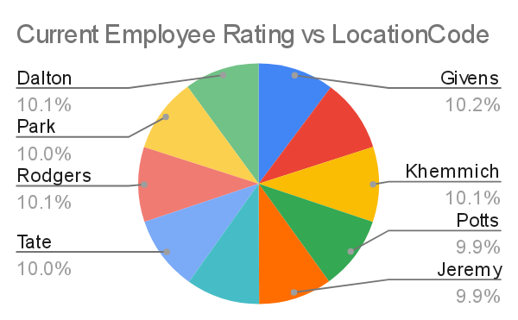
RESULT : PIE CHART

Slide 12
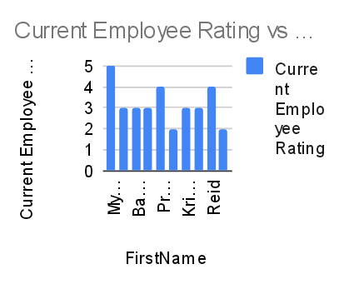
BAR DIAGRAM

Slide 13
DISCUSSION
Interpret result , highlighting key Trends high insights and implications for retention strategies discuss areas for further analysis and potential intervention

Slide 14
CONCLUSION
Summaries the value of using pivot tables for employee turnover analysis emphasize actionable insights data driven decision making and improved retention strategies

